Slide 1
React JS
Forms,CSS styling,SASS styling

Slide 2
Agenda
Design A Form in React
Apply the style in components
Apply styles using CSS
Apply styles using SASS
Working with Events in React components
Hands on Exercise
Day 24
React Routing
React Routing Basics
Create Routing
Working with browserRouters and routes
Conditional Rendering
Navigate Route programmatically

Slide 3
Design A Form
// src/MyForm.js
import React, { useState } from 'react';
const MyForm = () => {
const [formData, setFormData] = useState({
name: '',
email: '',
});
const [submitted, setSubmitted] = useState(false);
const handleChange = (e) => {
const { name, value } = e.target;
setFormData((prevData) => ({
...prevData,
[name]: value,
}));
};
const handleSubmit = (e) => {
e.preventDefault();
console.log('Form submitted:', formData);
setSubmitted(true);
};
return (
<div>
<h2>Simple Form</h2>
{submitted && <p>Form submitted successfully!</p>}
<form onSubmit={handleSubmit}>
<div>
<label>
Name:
<input
type="text"
name="name"
value={formData.name}
onChange={handleChange}
required
/>
</label>
</div>
<div>
<label>
Email:
<input
type="email"
name="email"
value={formData.email}
Creating a form in React is straightforward. Below is a simple example of a form component that includes fields for a user’s name and email, along with a submit button.
This example demonstrates controlled components, where the form elements are controlled by React state.
Example Code
Set up a new React app (if you haven't already):
npx create-react-app my-form-app
cd my-form-app
npm start
Create a Form Component:
Create a file named MyForm.js in the src directory and add the following code:

Slide 4
Form
onChange={handleChange}
required
/>
</label>
</div>
<button type="submit">Submit</button>
</form>
</div>
);
};
export default MyForm;

Slide 5
Understanding JSX Basics
JSX is Not HTML:
While JSX looks like HTML, it’s not. JSX tags are compiled into JavaScript, and each JSX element is transformed into a React element (e.g., React.createElement).
The JSX <div></div> tag, for instance, is transformed into React.createElement('div', null).
JSX Components:
JSX also supports using components in the same way as HTML tags. Components must be capitalized, or else React will interpret them as native HTML tags.
function Welcome() {
return <h1>Hello, World!</h1>;
}
const element = <Welcome />;

Slide 6
Understanding JSX Basics
Attributes in JSX:
JSX supports passing attributes to elements, just like in HTML. In JSX, attributes are passed using camelCase for HTML attributes (e.g., className instead of class).
JavaScript expressions can also be passed as attributes by enclosing them in curly braces.
const element = <img src={imagePath} alt="Example" />;
Self-Closing Tags:
Like in XML, tags without children can be self-closing in JSX.
const element = <img src="image.png" />;
Fragment Syntax:
JSX must have a single enclosing tag, but if you don't want to add extra HTML elements like <div>, you can use React Fragments (<></> or <React.Fragment></React.Fragment>) to wrap adjacent JSX elements without adding extra nodes to the DOM.

Slide 7
Understanding JSX Basics
return (
<>
<h1>Title</h1>
<p>Description</p>
</>
);

Slide 8
Babel: Transforming JSX into JavaScript
Since browsers don’t understand JSX natively, it needs to be compiled into standard JavaScript. This is where Babel comes in.
What is Babel?
Babel is a JavaScript compiler that is widely used to transform ECMAScript 6+ (ES6+) code into backward-compatible versions for older browsers. It can also transform JSX syntax into plain JavaScript that browsers can understand.
JSX and Babel Transformation:
When you write JSX, Babel transforms it into React.createElement() calls. For example:
jsx
const element = <h1>Hello, world!</h1>;
This would be transformed by Babel into:
const element = React.createElement('h1', null, 'Hello, world!');

Slide 9
Babel: Transforming JSX into JavaScript
The React.createElement() function takes three arguments:
Type: The type of element (e.g., 'div', 'h1', or a custom component).
Props: An object representing the properties (attributes) of the element.
Children: The children elements or content of the element.
Why Babel?
Modern JavaScript Compatibility: Babel allows you to write modern JavaScript (e.g., ES6, ES7) and JSX, and it compiles this code down to a version that older browsers can understand.
React Compatibility: Babel transforms JSX syntax into valid JavaScript (React.createElement() calls) that React uses internally to build the UI.
Babel Configuration
To use Babel in a project, you typically include it in your build process using tools like Webpack or Parcel. In your configuration, you define the presets and plugins you need for your project.
For React with JSX, you would typically use the following Babel preset:

Slide 10
Babel: Transforming JSX into JavaScript
{
"presets": ["@babel/preset-react"]
}
This preset tells Babel to handle JSX syntax and transform it into JavaScript.
Example Workflow with Babel:
Write JSX:
You write JSX in your .jsx or .js files.
const element = <h1>Hello, Babel!</h1>;
Babel Compiles the JSX:
Babel transforms your JSX code into vanilla JavaScript that browsers can execute.
const element = React.createElement('h1', null, 'Hello, Babel!');
Run in Browser:
The browser executes the compiled JavaScript code and renders the React component to the DOM.

Slide 11
Babel: Transforming JSX into JavaScript
Babel in Development vs. Production
Development: Babel compiles JSX and ES6+ code during development to allow for more modern and readable code. It’s integrated with other tools like Webpack to provide hot-reloading, better error messages, etc.
Production: For production builds, Babel can be configured to optimize the compiled JavaScript for performance, like minifying and removing unnecessary code
JSX is a syntax extension that allows developers to write more expressive UI code that mixes HTML-like tags with JavaScript logic. It enhances code readability and makes it easier to build complex UIs in React.
Babel is crucial in transforming JSX and modern JavaScript into browser-compatible code, allowing developers to take advantage of the latest language features while ensuring compatibility with older environments. Together, JSX and Babel form a core part of the modern React development ecosystem.

Slide 12
React Components
React components are the building blocks of a React application. They allow you to split the UI into independent, reusable pieces and manage each part in isolation. There are two primary types of React components: Functional Components and Class Components.
1. Functional Components
Functional components are the simplest way to write components in React. They are JavaScript functions that take in props (properties) as arguments and return JSX. Functional components do not manage their own state or lifecycle directly, but with the introduction of hooks (like useState, useEffect), functional components can now handle state and side effects, making them more versatile.
Example:
function Greeting(props) {
return <h1>Hello, {props.name}!</h1>;
}

Slide 13
React Components
Advantages of Functional Components:
Easier to read and test.
Perform better because they don’t have the overhead of lifecycle methods.
They are "stateless" (although this changed with hooks).
Using Hooks in Functional Components:
With hooks, you can manage state and lifecycle features in functional components.
import React, { useState } from 'react';
function Counter() {
const [count, setCount] = useState(0);
return ( <div> <p>You clicked {count} times</p> <button onClick={() => setCount(count + 1)}>Click me</button> </div> ); }In this example:
useState(0) initializes the state variable count with a value of 0.
setCount is a function that updates the count state.

Slide 14
Components
2. Class Components
Class components are more feature-rich than functional components. They were the traditional way of writing components before React introduced hooks. Class components extend the React.Component class and can maintain internal state and lifecycle methods.
Example:
class Welcome extends React.Component {
render() {
return <h1>Hello, {this.props.name}!</h1>;
} }

Slide 15
State and Props in Class Components:
State and Props in Class Components:
Props: Similar to functional components, props are passed down from parent components. They are accessed in class components using this.props.
State: State is managed internally in class components, using this.state, and updated using this.setState().
State Example in a Class Component:
class Counter extends React.Component {
constructor(props) {
super(props);
this.state = { count: 0 };
}
increment = () => {
this.setState({ count: this.state.count + 1 });
}
render() {
return (
<div>
<p>Count: {this.state.count}</p>
<button onClick={this.increment}>Increment</button>
</div>
); }}

Slide 16
State and Props in Class Components:
In this example:
this.state holds the component's local state.
this.setState() is used to update the state, causing the component to re-render.
render() is a required method in class components, which returns the JSX to be rendered.
3. Stateful vs Stateless Components
Stateful Components: Components that manage and maintain their own state. Typically, class components or functional components using hooks are stateful.
function StatefulComponent() {
const [state, setState] = useState('Hello');
return <p>{state}</p>;
}

Slide 17
State and Props in Class Components:
function Greeting(props) {
return <h1>Hello, {props.name}!</h1>;
}
function App() {
return (
<div>
<Greeting name="Alice" />
<Greeting name="Bob" />
</div>
);
}
The Greeting component receives the name prop and displays it. Props are passed like attributes in HTML.
Stateless Components: Components that do not manage their own state, and simply render based on the props they receive. Functional components without hooks are stateless.
function StatelessComponent(props) {
return <p>{props.message}</p>;
}
4. Props
Props are inputs to React components. They allow data to be passed from parent to child components and are read-only (i.e., immutable). Components use props to render dynamic content.
Example of Passing Props:

Slide 18
5. Lifecycle Methods (in Class Components)
class Clock extends React.Component {
constructor(props) {
super(props);
this.state = { time: new Date() };
}
componentDidMount() {
this.timerID = setInterval(() => this.tick(), 1000);
}
componentWillUnmount() {
clearInterval(this.timerID);
}
tick() {
this.setState({ time: new Date() });
}
render() {
return <h1>{this.state.time.toLocaleTimeString()}</h1>;
}}
React class components have lifecycle methods that allow you to hook into different stages of the component's life (e.g., mounting, updating, unmounting).
Mounting: The moment the component is inserted into the DOM.
componentDidMount(): Called after the component is mounted.
Updating: When the component's state or props change.
componentDidUpdate(): Called after the component is updated.
Unmounting: When the component is removed from the DOM.
componentWillUnmount(): Called just before the component is unmounted and destroyed.
In this example:
componentDidMount() sets up a timer when the component is first mounted.
componentWillUnmount() cleans up the timer when the component is removed.

Slide 19
Controlled Components (Forms)
6. Controlled Components (Forms)
In React, form elements such as <input>, <textarea>, and <select> are usually controlled components. This means that their values are controlled by React state.
Example of Controlled Component:
In this example:
The value of the input field is tied to the name state variable.
onChange handler updates the state, making this a controlled input.
function NameForm() {
const [name, setName] = useState('');
const handleChange = (event) => {
setName(event.target.value);
}
return (
<form>
<label>
Name:
<input type="text" value={name} onChange={handleChange} />
</label>
<p>Your name is: {name}</p>
</form>
);
}

Slide 20
7. Higher-Order Components (HOCs)
7. Higher-Order Components (HOCs)
A Higher-Order Component (HOC) is a function that takes a component and returns a new component. HOCs are used for reusing component logic.
Example of an HOC:
function withLogger(WrappedComponent) {
return function LoggerComponent(props) {
console.log('Rendering component with props:', props);
return <WrappedComponent {...props} />;
};
}
const HelloWithLogger = withLogger(Hello);

Slide 21
How to Syle React Components
Styling in React Components can be done by using CSS with different approaches, using CSS frameworks, and using the components from UI libraries.
There are about eight different ways to style React JS components, there names and explanations of some of them are mentioned below.
Inline CSS
Normal CSS
CSS in JS
Styled Components
CSS module
Sass & SCSS
Less
Stylable

Slide 22
Introduction to the routing library
Introduction to the routing library
There are multiple ways to implement routing in React applications, such as by creating custom hooks. However, this approach is time-consuming, as it requires the creation of separate hooks for individual features.
Instead, we can use a feature-rich library, such as react-router, which is recommended by the React team. Top companies like Facebook, Netflix, Microsoft, and Discord all use this library.

Slide 23
What is react-router?#
What is react-router?
The react-router is a routing library for React. Official documentation describes it as a fully-featured client-side and server-side routing library for React, a JavaScript library for building user interfaces.
We can use react-router on the web, NodeJS, and React Native. It has several advantages:
The react-router is mainly used to make single-page applications (SPA). It maintains the behavior and structure of the web application.
It allows us to use different browser functionalities such as refresh, back button, and locate objects.
It’s easy to use and reduces the amount of code we have to write.
It allows for navigation without refreshing the page. Because of this, we can maintain different states in our application.
It provides many features like navigation, URL params, and passing props to components.

Slide 24
Do we need to use react-router in all React applications?#
We don’t need to use react-router if we develop a simple application or website that only needs minimal navigation and routing.
We can also use react hooks to achieve some basic routing functionalities. However, if we want complex navigation and to display multiple views in a single page application, we should use it in our React applications.

Slide 25
How does react-router work in the browser?#
Location: Each browser has a location object. We can access it via window.location and document.location. It can be used to get the current URL.
Tip: Open the console in a browser tab and type window.location to get the whole location object.
History: This is the same as window.location. We can also try window.history, which returns a history object, which provides an interface to manipulate browser session history, including pages visited in the tab where the current page is loaded.
History stack: As the user navigates through different parts of the web app, the browser keeps track of each location in a stack called the history stack.

Slide 26
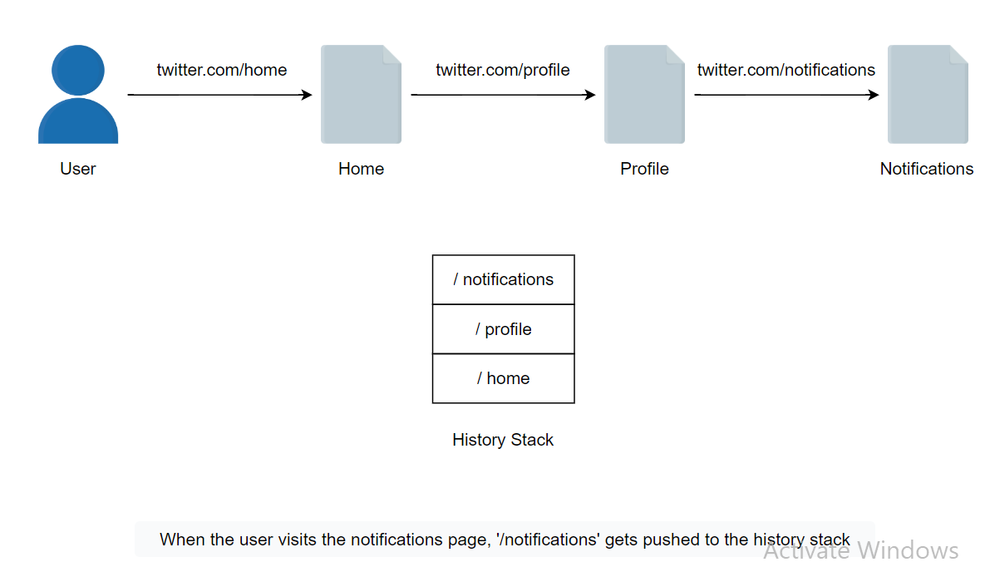
History stack: As the user navigates through different parts of the web app, the browser keeps track of each location in a stack called the history stack.

Slide 27
Three actions can be performed on the history stack:
Push: When a user clicks a link, it gets pushed to the history stack.
Replace: This replaces the current entry in the history stack with the new one.
Pop: This happens when the user clicks on the forward or back button in the browser and stores the previous state.
Routes: These are objects that contain a path and an element. When the path matches the current URL, the element is rendered.

Slide 28
react-router does the following three operations:
react-router does the following three operations:
1. Subscribing and manipulating the history stack
First, react-router has to subscribe to changes in the browser history stack.
During server-side routing, the browser makes a request to a server for each URL change. However, we can manipulate the history stack through window.history in client-side routing.
Using browser APIs, react-router changes the URL without the browser’s default behavior of sending a request to the server.
<a
href="/contact"
onClick={(event) => {
// stop the browser from changing the URL and requesting the new document
event.preventDefault();
// push an entry into the browser history stack and change the URL
window.history.pushState({}, undefined, "/contact");
}}
/>
The above code is only an example, and eact-router doesn’t use the same code in its implementation

Slide 29
event.preventDefault(): This prevents the browser from changing the URL and sending a request to the server.
pushState(): This adds an entry to the browser’s session history stack.
The web browser doesn’t allow us to observe these URL changes. However, the react-router specific history object allows us to observe such changes whether the history action is a Push, Pop, or Replace.
let history = createBrowserHistory();
history.listen(({ location, action }) => {
// this is called whenever new locations come in
// the action is POP, PUSH, or REPLACE
});
The react-router provides a way to observe URL changes.
This whole operation happens internally, so we don’t have to write this code manually. This is just an example to help us understand how it works.

Slide 30
2. Matching the URL to the routes
When the URL in the address bar changes, react-router matches the URL with the routes defined by the user.
2. Matching the URL to the routes
When the URL in the address bar changes, react-router matches the URL with the routes defined by the user.
3. Rendering a nested UI from the route matches
When the URL in the address bar matches the specific route path, react-router renders the element defined in the route object. The official documentation, found here, goes into more detail.
The react-router isn’t just a standard library. It’s highly recommended by the React team and provides features that can save us from writing a huge amount of code. Anyone developing a website with multiple pages should seriously consider using react-router. Behind the scenes, it uses history objects and a few other APIs provided by the browser. Despite its impressive utility, its size is less than 0.5Mb.

